Slide 1
Restaurant attributes and HOW They affect yelp ratings
MACS 30200
Fangfang Wan

Slide 2
Why it’s interesting?
We can see what makes a restaurant highly rated – valuable for restaurant owners
We can see if a rating is fair in our own perspective – valuable for guests

Slide 3
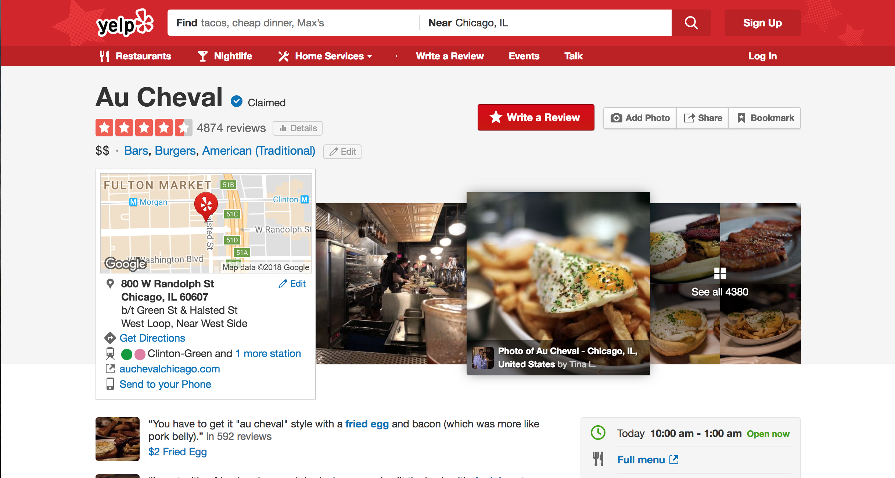
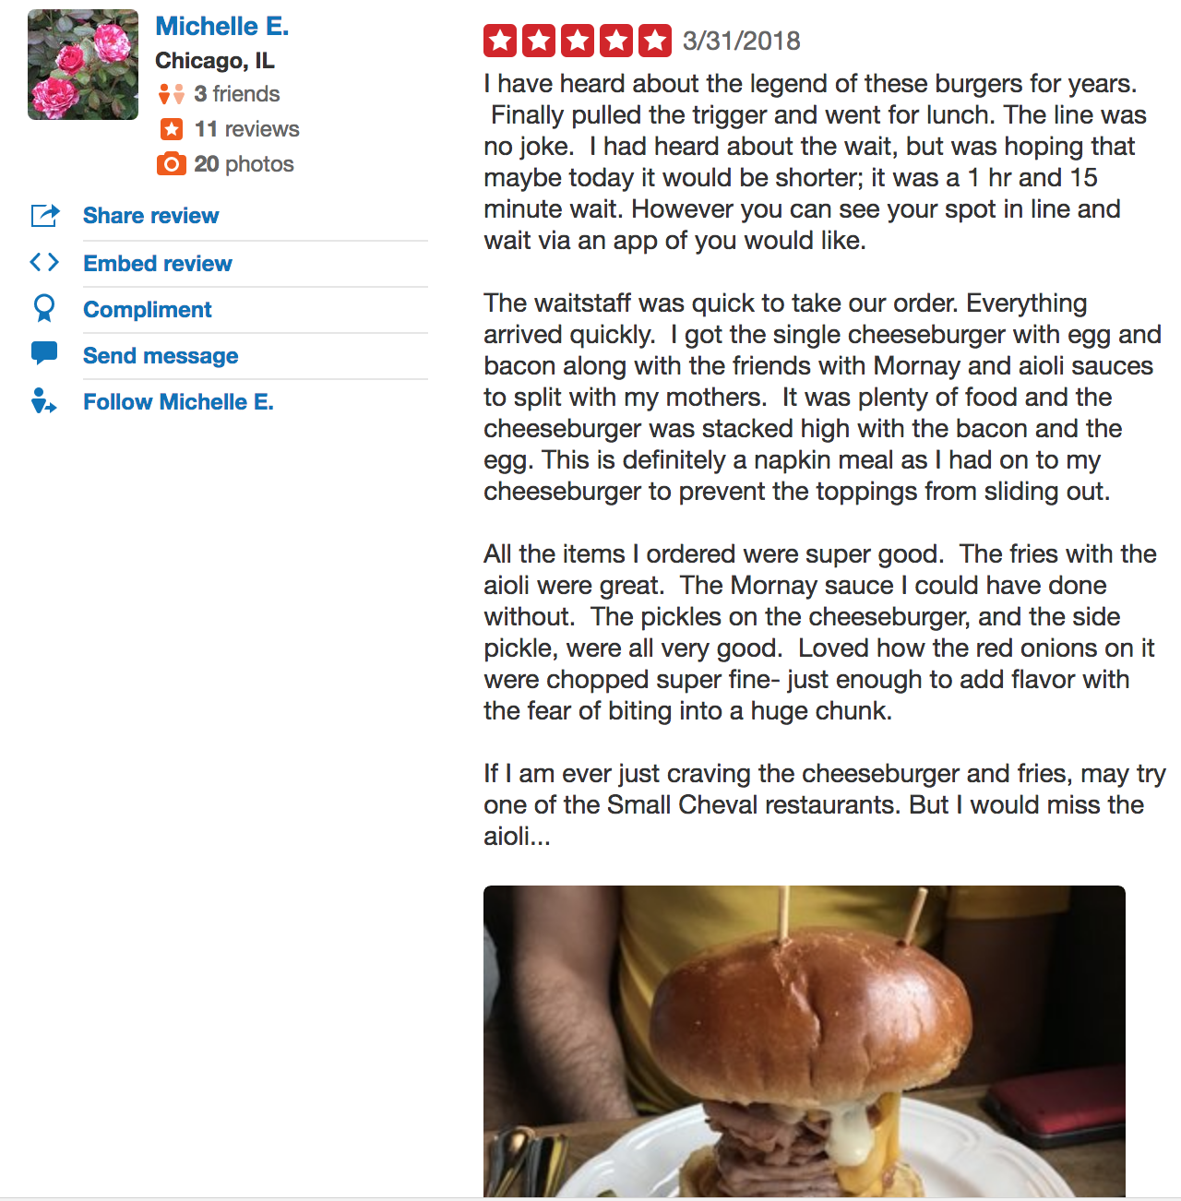
Example
Screenshot from Yelp

Slide 4
Contribution
Add evidence to business researches
Provide guidance on how to improve Yelp rating for restaurants, and then revenue (Luca, 2016)

Slide 5
Literature Review
Luca, M. (2016). Reviews, reputation, and revenue: The case of Yelp.com
Byers, J. W., Mitzenmacher, M., & Zervas, G. (2012, June). The groupon effect on yelp ratings: a root cause analysis. In Proceedings of the 13th ACM conference on electronic commerce (pp. 248-265). ACM.

Slide 6
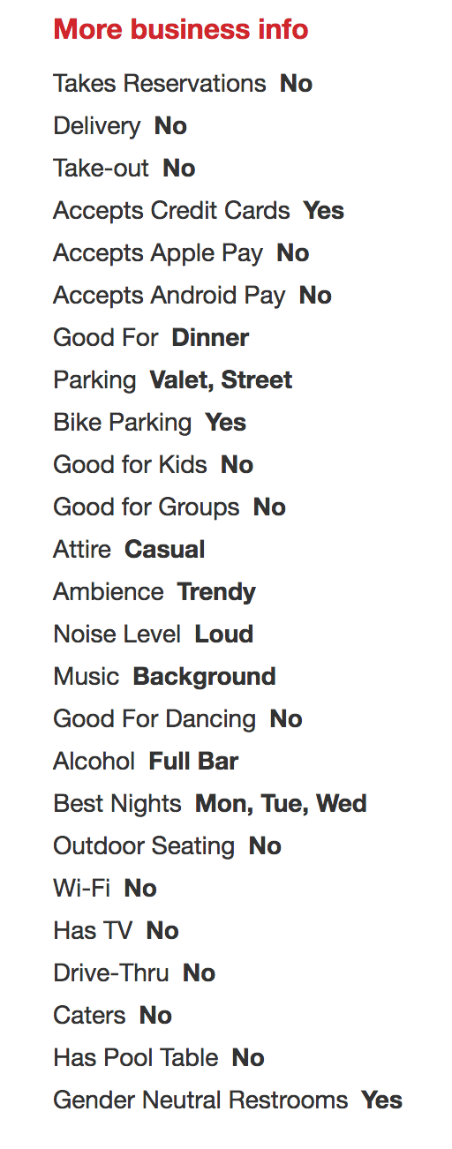
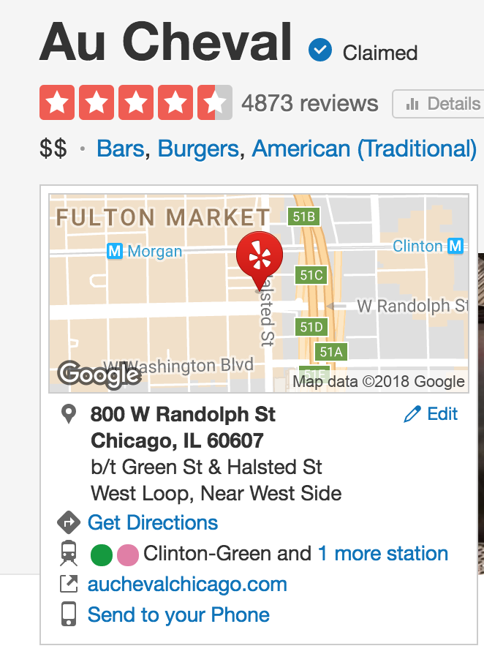
Data
Web scraping from Yelp html.

Slide 7
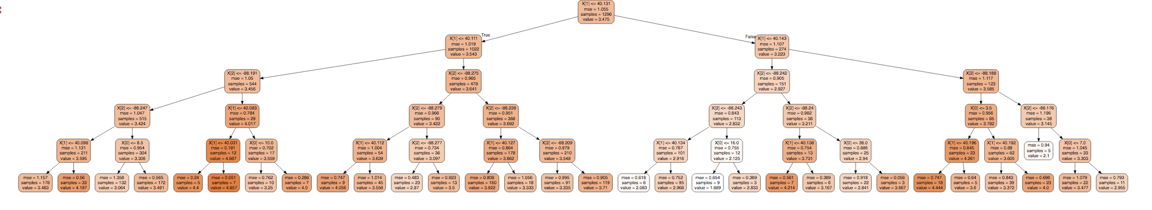
Data Plot (all businesses in IL as an example. Data from https://www.kaggle.com/yelp-dataset/yelp-dataset/data)

Slide 8
Theory
Not exactly a theory in strict sense –
How do restaurant owners’ behaviors affect Yelp rating?
Byers, J. W., Mitzenmacher, M., & Zervas, G. (2012, June). The groupon effect on yelp ratings: a root cause analysis. In Proceedings of the 13th ACM conference on electronic commerce (pp. 248-265). ACM.

Slide 9
Model and Tentative results
Model:
Decision tree
Linear regression
X: attributes of a restaurant (price level, parking, accept Apple Pay, etc.) y: Yelp rating of a restaurant
Tentative results:
Restaurants that offer parking, with higher price level, offer alcohol, etc. may have higher Yelp ratings.

Slide 10
Computational tools
Computational methods: Mainly Python
Linear Regression
Tree-based methods
Web scraping

Slide 11
Thank you!

